Slide 1
ETL ERROR HANDLING
By - G Harsha vardhan (37110270)
Under the guidance of Mr.A.Yovan Felix,M.E.,(Ph.D).,

Slide 2
OBJECTIVES
To extract data from source data bases,transform and cleanse the data and load it into a target database.
In Vehicle Service Data set The CustomerID field does not contain duplicate records.
There are errors in the data. Find them
Suggest explanation how each of the errors could have occurred and what you think is the best way to fix each one.
You know that the total projected revenue for 2016 equals: $419,896,187.87.You need the uploaded data to match this value (this means that every row is important)

Slide 3
INTRODUCTION
ETL full-form is Extract, Transform and Load.ETL is defined as a process that extracts the data from different source systems, then transforms the data (like applying calculations, concatenations,etc.) and finally loads the data into the Data Warehouse system.
In this Process vehicle service Data is cleaned by using Excel and Notepad++.
Cleaned data is Source for the SSIS process using SSDT via Visual studio. In this process bad records are eliminated if there is any row shift or column shift. Good records are sent to OLEDB destination.
SSIS is Connected to SSMS to access, configure, manage, administer, and develop all components of SQL Server, and SQL Data Warehouse

Slide 4
LITERATURE SURVEY
S.No | PAPER TITLE | AUTHORS | PUBLISHED DATE | ADVANTAGES | DISADVANTAGES
[1] | Data ware house Testing | Hajor Homayouni,Sudipto Ghosh,Indraskhi Ray | 2017 | Easy process. Support Most of the Data sets. | Time Consuming
[2] | Data ware house Testing process | Manoj Philip Mathen | 2010 | Testing and data ware house implementation is easy. | Not applicable to all type of data sets
[3] | Building a Data ware house with examples in SQL Server | Vincent Rainardi | 2008 | Supports SQL Server 2005 or Later, Easy to Use. | Difficult process for Dealing with Large data.

Slide 5
[4] | A Case Study on Regression Test Automation for Data Warehouse Quality Assurance. | T.N.Manjunath,RavindraS.Hegad,H.K.Yogish,R.A.Archana,andI.M.Umesh. | 2012 | Data Quality can be checked through out the process. | More complex and time consuming process.
[5] | Data Warehousing and Knowledge Discovery. | Mukesh,K.Mohania and A.Min Tjoa | 2010 | It reduces testing efforts, It can be re-usable logic for one or more test cases, it’s more accurate than manual testing. And also it’s easy to operate. | all the test cases which need to be automated and assigned unique id for each test

Slide 6
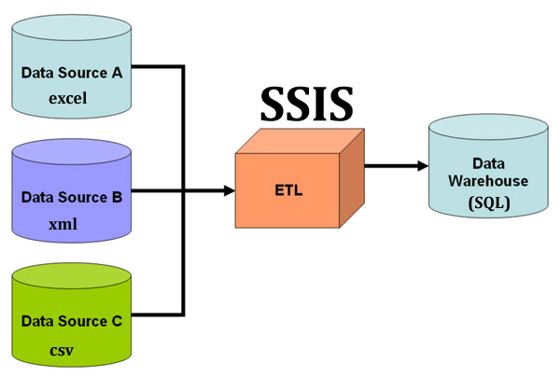
ETL FLOW DIAGRAM

Slide 7
DATA CLEANING
Data cleaning is the part of the ETL process
The purpose of data cleansing is to detect so called dirty data (incorrect, irrelevant or incomplete parts of the data) to either modify or delete it to ensure that a given set of data is accurate and consistent with other sets in the system.
The importance of regular data cleansing is unquestionable in any data based or data dependent business as using inaccurate and inconsistent data can cause serious problems on various levels (e.g.. government's wrong fiscal decisions based on unreliable data or loss of business partners when basing on outdated contact information)

Slide 8
SQL SERVER INTEGRATION SERVICES (SSIS)
Microsoft SQL Server Integration Services (SSIS) is a platform for building high performance data integration solutions, including extraction, transformation, and load (ETL) packages for data warehousing.
SSIS is basically an ETL tool part of the Microsoft Business Intelligence suit that is mainly used to achieve Data Integration.
The primary use for SSIS is data warehousing as the product features a fast and flexible tool for data extraction, transformation, and loading (ETL). The tool may also be used to automate maintenance of SQL Server databases, update multidimensional cube data, and perform other functions.

Slide 9
SQL SERVER MANAGEMENT STUDIO (SSMS)
SSMS or SQL Server Management Studio is a graphical interface to manage SQL Server. You can manage SQL Server several other ways such as using tsql or PowerShell.
SSMS Gives accurate, actionable, detailed metrics to quickly identify and address database problems.
SSMS is to query, design, and manage databases and data warehouses, wherever they are in the local computer, or in the cloud.
With SQL Queries,we can effectively monitor, diagnose, and optimize your entire database environment.

Slide 10
FEATURES AFFECTING ETL PROCESS
The key factors to be consider in the ETL Process
Check if ETL tool supports data quality/ cleansing
Ensure version control of the ETL maps
Data consistency
Data Quality

Slide 11
RESULT
As a result of all these efforts, errors in the data are Handled. Conditional Shift Statement is used to eliminated the bad records if there is an Row shift Or column shift in the data by using SQL Server Data tools(SSDT) in the SQL Server Integration Services(SSIS) via Visual studio.
Errors in the good records are found using SQL Queries in the SQL Server Management Studio(SSMS). where string value in column 2015 where 3211647 as CustomerID , two duplicates records are found with CustomerID 3490750, maximum value of column 2014 and total projected revenue for 2016 equals: $419,896,187.87.

Slide 12
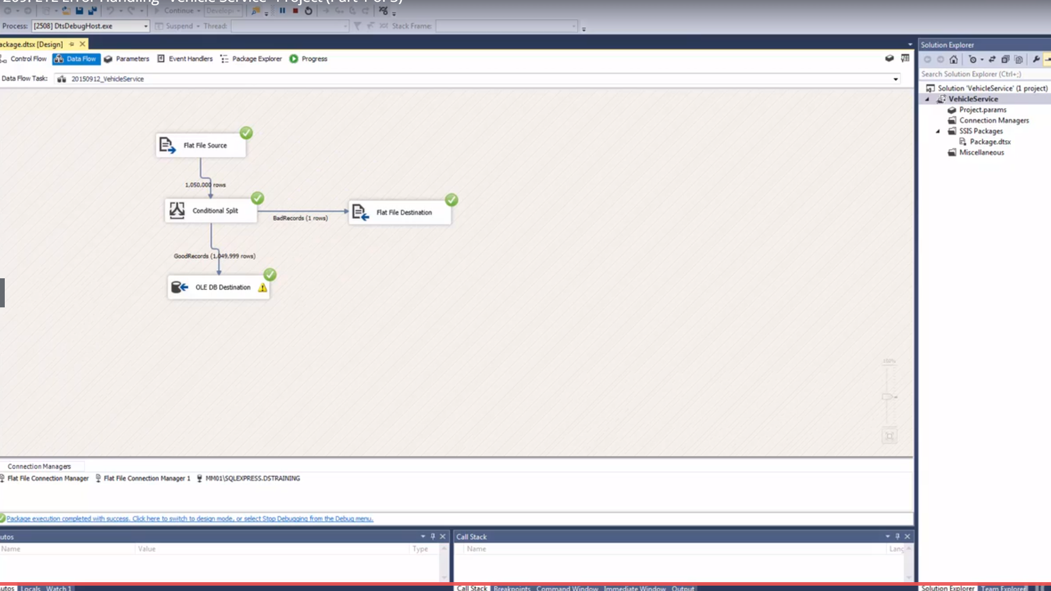
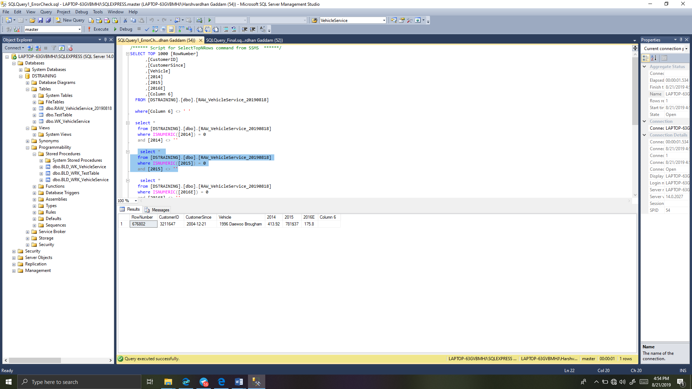
This figure shows the running of the SSIS Process to remove the bad records from the Vehicle service Data.
This figure to the right show the errors in the Good records that are identified using the Queries in the SSMS process.

Slide 13
CONCLUSION AND FUTURE SCOPE
CONCLUSION:
Thus, this project has been designed to clean the data and to handle the errors in the records which is later stored in the data ware house.
FUTURE SCOPE:
This project is further developed for the analysis and visualization process which delivers the result to end user for better understanding.

Slide 14
REFERANCES
[1] Qin Hanlin; Jin Xianzhen; Zhang Xianrong (2012), Extract, Transform and Load(ETL) in Land and Resources Star Schema Data Warehouse,Page 1
[2] Sasa Dupor; Vladan Jovanovic (2014),An approach to Conceptual modelling of ETL processes,Pages 1 to 5
[3] Huamin Wang ; Zhiwei Ye(2010) ,An ETL Services Framwork Based on Metadata,Pages 1 to 5
[4] Lilia Munoz ; Jose-Norberta Mazon ;Juan Trujillo(2011), ETL Process Modeling Conceptual for Data Warehouses: A Systematic Mapping Study,Volume 1,Pages 358 to 363

Slide 15

THANK YOU

